Slide 1

Plagiarism
Part 2 - Academic misconduct
SOLENT UNIVERSITY - COMPUTING SUBJECT GROUP

Slide 2
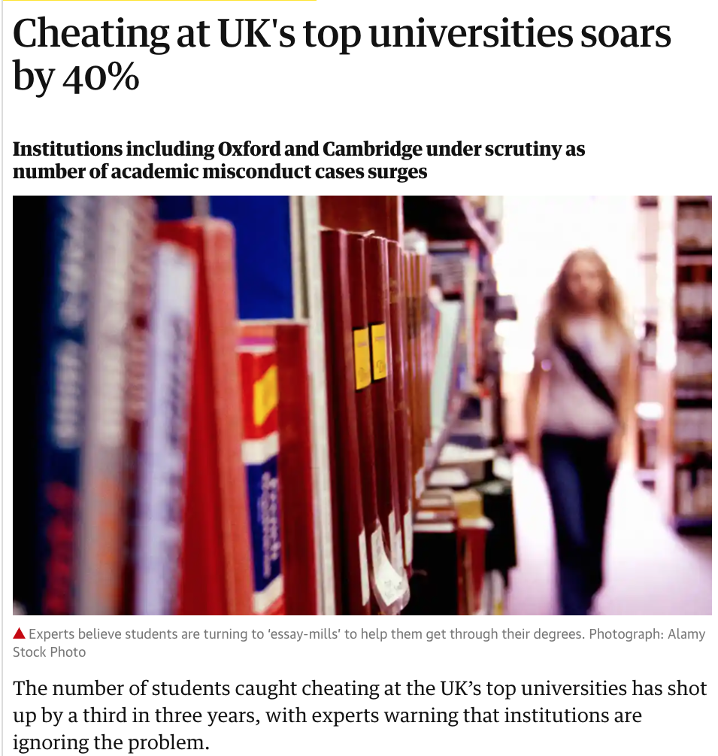
MARSH, S., 2018. Cheating at UK’s top universities soars by 40%. The Guardian, 29 April

Slide 3
Types of LEARNING
DIDACTIC v SOCRATIC
ROSÉ, C.P. et al., 2001. A comparative evaluation of Socratic versus didactic tutoring. 23rd Annual Conference of the Cognitive Science Society, 869–874 https://www.research.ed.ac.uk/portal/en/publications/a-comparative-evaluation-of-socratic-versus-didactic-tutoring(6199ecc5-144b-446f-bb8d-f48653a72cd8).html

Slide 4
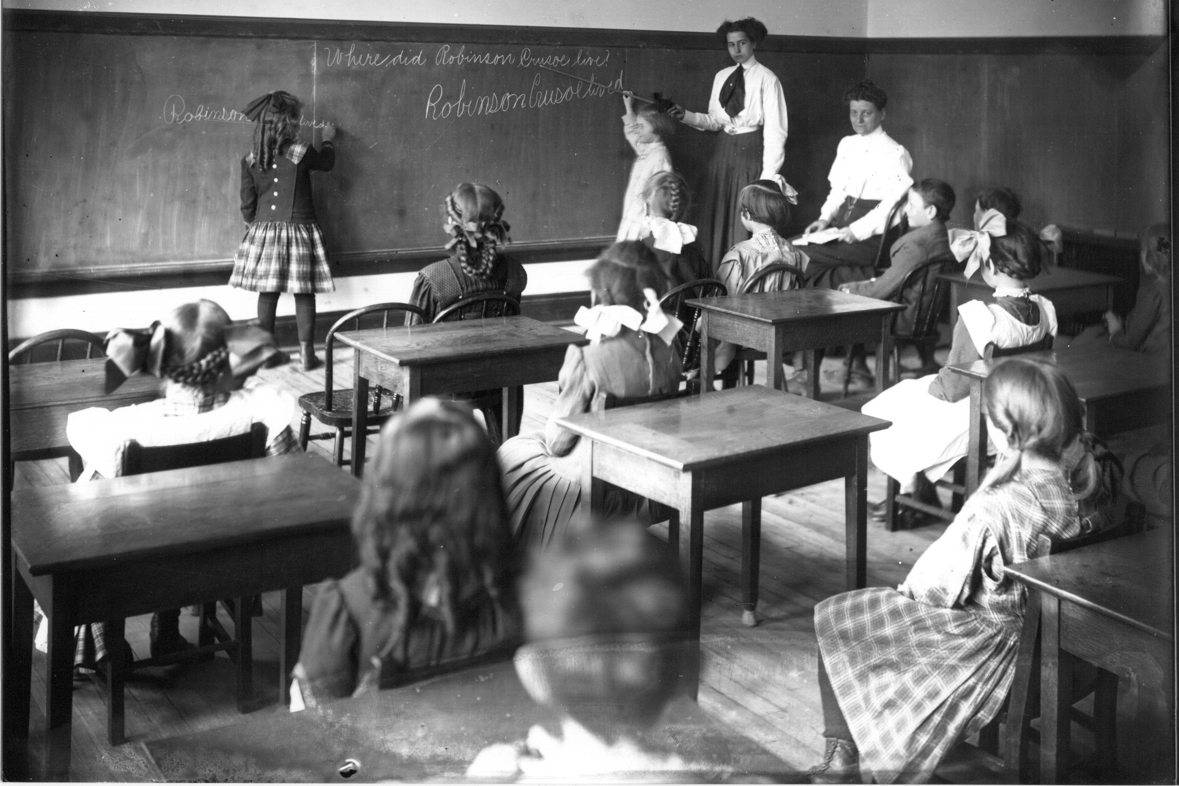
DIDACTIC
“The didactic tutoring style has the tutor beginning with an explanation of the material the student should learn followed by questioning that plays more of a role of drawing the student’s attention to the information that the tutor has already explained rather than eliciting this information from the student. “ Rose (2001)
Miss Logan in Ohio State Normal College Model School classroom 1911 flickr photo by Miami U. Libraries - Digital Collections shared with no copyright restriction (Flickr Commons)
ROSÉ, C.P. et al., 2001. A comparative evaluation of Socratic versus didactic tutoring. 23rd Annual Conference of the Cognitive Science Society, 869–874 https://www.research.ed.ac.uk/portal/en/publications/a-comparative-evaluation-of-socratic-versus-didactic-tutoring(6199ecc5-144b-446f-bb8d-f48653a72cd8).html

Slide 5
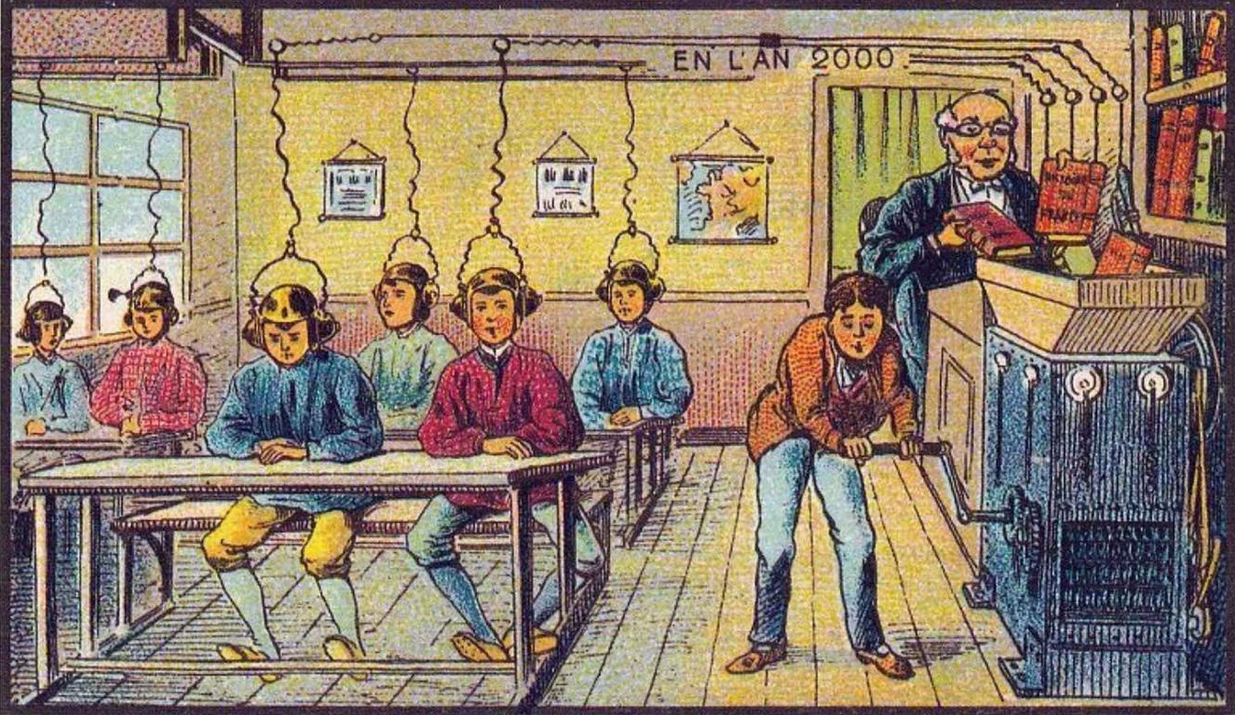
ASIMOV, I., 2016. levif.be - En 1900, voici comment on imaginait l'an 2000 [viewed Aug 16, 2017]. Available from: http://www.levif.be/actualite/international/en-1900-voici-comment-on-imaginait-l-an-2000/diaporama-normal-561915.html
Jean-Marc Côté

Slide 6
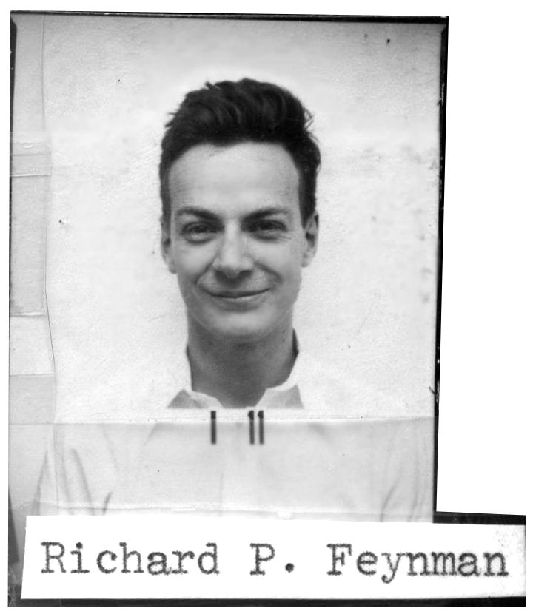
“…students had memorized everything…, but they didn’t know what anything meant… [or could] translate into meaningful words”.
Richard P Feynman
(Cited by Leighton 1992 p.213)
LEIGHTON, R., 1992. Surely You're Joking Mr Feynman: Adventures of a Curious Character as Told to Ralph Leighton. London. Vintage
Notes:
Richard Phillips Feynman was an American theoretical physicist known for his work in the path integral formulation of quantum mechanics, the theory of quantum electrodynamics
Feynman trip to Brazil. students there could answer exam problems with incredible speed, but they could not apply their “knowledge” at all to the real world.

Slide 7
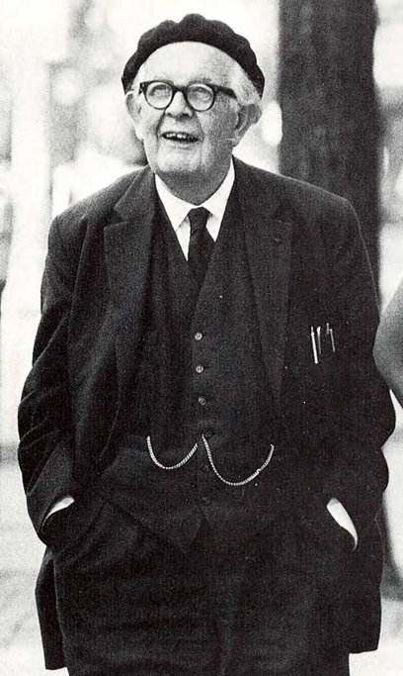
“The principal goal of education […] should be creating [people] capable of doing new things, not simply repeating…; who are creative, inventive and discoverers, who can be critical and verify, and not accept, everything they are offered.”
Jean Piaget
PIAGET (1971, p.27) cited in: Ernst von Glasersfeld "Homage to Jean Piaget (1896–1980)". In: Irish Journal of Psychology, 18, pp. 293–306
Notes:
Jean Piaget was a Swiss clinical psychologist known for his pioneering work in child development. Piaget's theory of cognitive development and epistemological view are together called "genetic epistemolog

Slide 8
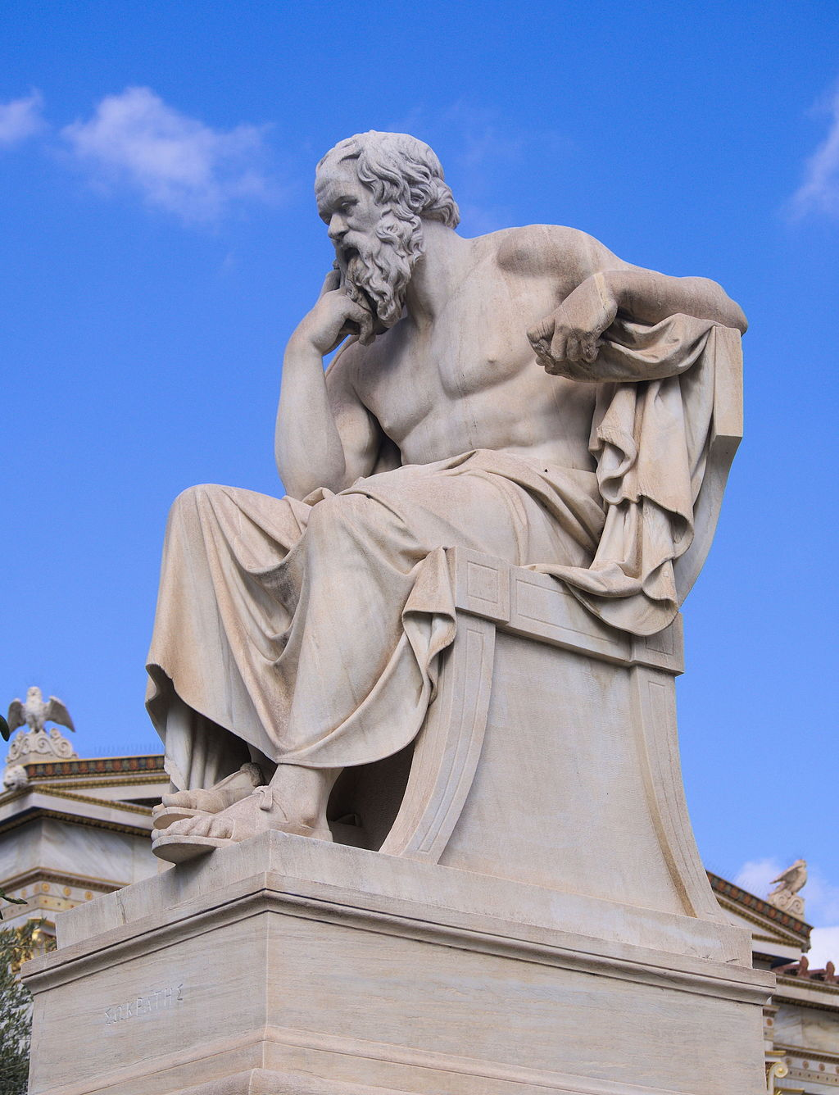
SOCRATIC
Cooperative discussion & argument between individuals, based on asking and answering questions to stimulate critical thinking
FACINGHISTORY.ORG., 2020. Socratic Seminar [viewed 29 April 2020]. Available from: https://www.facinghistory.org/resource-library/teaching-strategies/socratic-seminar
image: Socrates - Greek philosopher

Slide 9
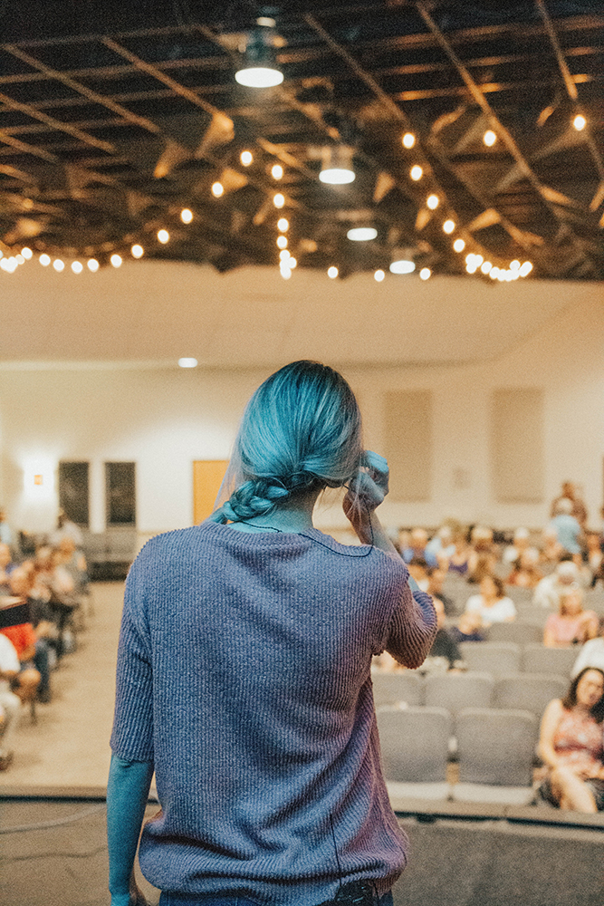
SOCRATIC
”Socratic is eliciting information from students through a direct line of reasoning. The tutor endeavours as much as possible to avoid giving information away.”
Rose (2001)
ROSÉ, C.P. et al., 2001. A comparative evaluation of Socratic versus didactic tutoring. 23rd Annual Conference of the Cognitive Science Society, 869–874 https://www.research.ed.ac.uk/portal/en/publications/a-comparative-evaluation-of-socratic-versus-didactic-tutoring(6199ecc5-144b-446f-bb8d-f48653a72cd8).html

Slide 10

PLAGIARISM
“where a student incorporates another person's or body's work by unacknowledged quotation, paraphrase, imitation or other device in any work submitted for assessment in a way which suggests that it is the student's original work”

Slide 11

Complete plagiarism is when student deletes the author/s name/s and adds their own name.
Direct or verbatim plagiarism occurs when an author copies the text of another author, word for word, without the use of quotation marks or attribution, thus passing it as their own work.
Auto-plagiarism, also known as self-plagiarism or duplication, happens when an author reuses significant portions of their previously published work without attribution.
Accidental Plagiarism whether intended or unintended, there is no excuse for plagiarism and the consequences are often the same.
ENAGO.COM., 2020. 8 Most Common Types of Plagiarism to Stay Away from! In: Enago Academy. 25 March 2018 [viewed 28 April 2020]. Available from: https://www.enago.com/academy/fraud-research-many-types-plagiarism/

Slide 12
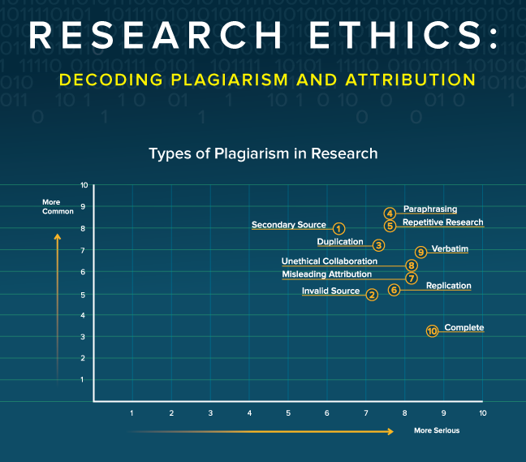
EASSOM., H. 2016, 10 types of plagiarism in research [viewed 28 April 2020]. Available from: https://www.wiley.com/network/researchers/submission-and-navigating-peer-review/10-types-of-plagiarism-in-research

Slide 13

COLLUSION

Slide 14

COPY PASTE

Slide 15
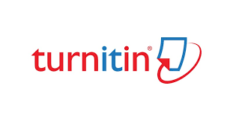
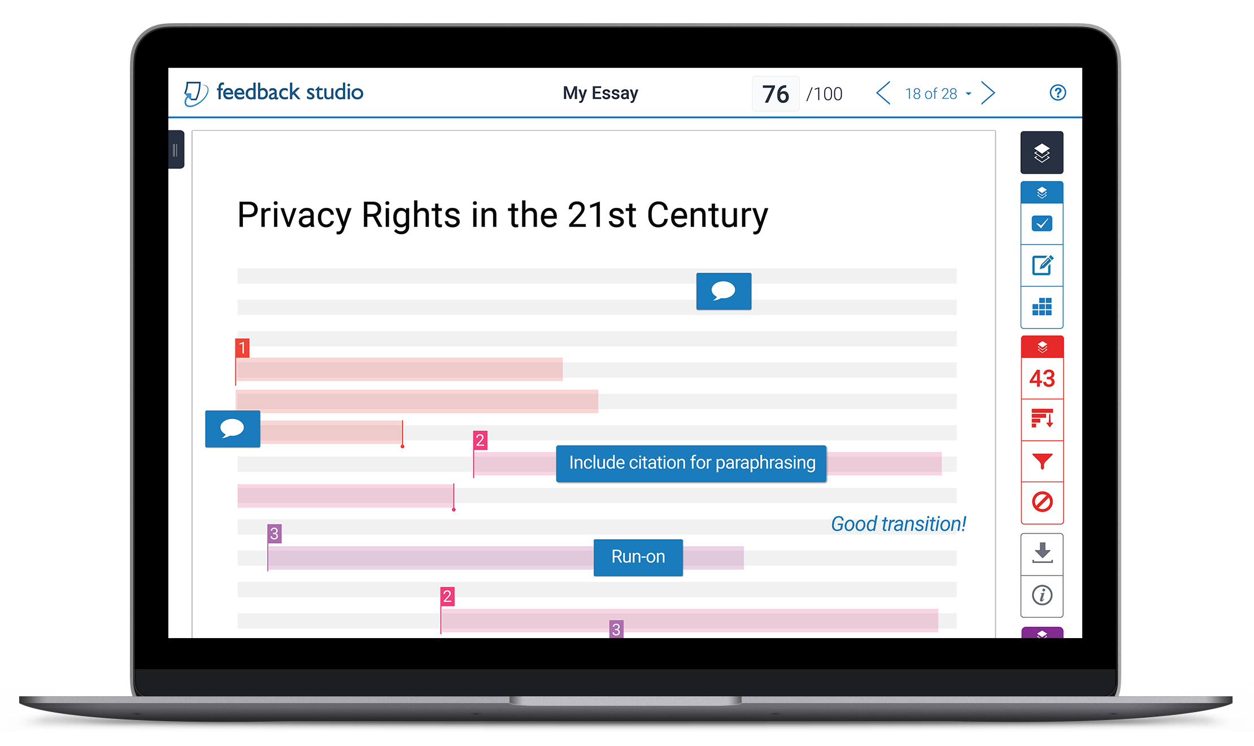
TURNITIN., 2020. Feedback Studio [viewed 29 April 2020]. Available from: https://www.turnitin.com/products/feedback-studio

Slide 16
